Slide 1
Sharp

Slide 2
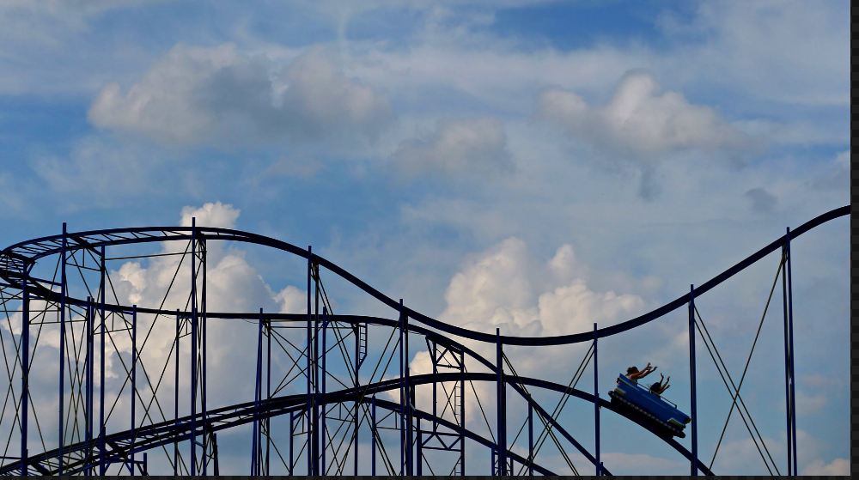
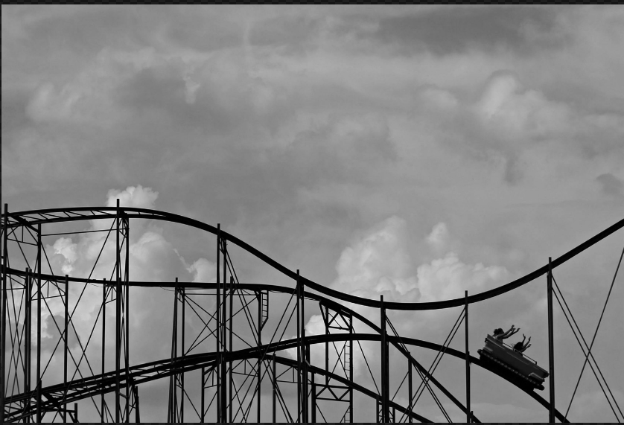
Change image color - grayscale
Converting image to black and white.
toColourspace('b-w')

Slide 3
Resize images
Change image resolution, to make thumbnails or small images to fit mobile / ipad screens.
Advantages :- small size, faster transfer.
.resize(3000, 2000)
File Structure miniooo:
Main file as folder name…Various file size created as subfolder
SellerID / Bucket/Product / original-date.now-imagename.jpg
SellerID / Bucket/Product / original-imagename/Mobile-REsized-images/
………………………………./Desktop/
………………………………./Ipad/

Slide 4
Minio DB
You can’t create bucket inside bucket. But you can create folder like structure by hack, by adding folder name with object / image.
Create db accordingly.

Slide 5
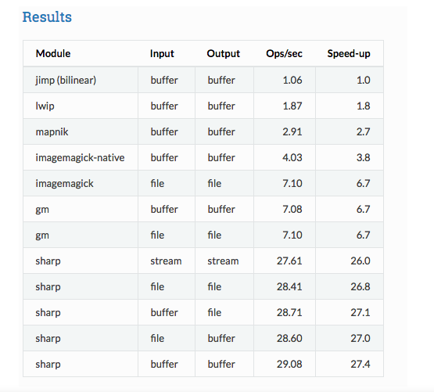

Slide 6
Refreences
http://sharp.pixelplumbing.com/en/stable/api-constructor/
https://github.com/lovell/sharp
https://sharp.readthedocs.io/en/v0.11.1/api/#input
Dependencies
Install python, nw.js set environment, below link for hack windows. vaiables(http://docs.nwjs.io/en/latest/For%20Users/Debugging%20with%20DevTools/)
Node.js new 11.4 current version install chocolatey, visual studio

